Slide 1
Final Presentation
Nitish Manandhar
Trainee at Verscend

Slide 2
Health and Insurance in the US:
Insurance means the compensation against some form of loss
Health Insurance is the insurance for the persons health
Health Insurance in the US is different than other places
Health care cost is very high in the US

Slide 3
US Population
Insured
Uninsured
Public Insurance
Private Insurance
Medicare
Medicaid
Other
Individual
Employer sponsored
Exchanges

Slide 4
Health Insurance Portability and Accountability Act(HIPPA)
Primarily created to protection of Protected health information(PHI)
Protected health information (PHI) contains information about the individual
health coverage for workers if they are moving office

Slide 5
Oracle Database:
Oracle DB is a relational database
Types of SQL statements:
DDL( Create, Drop)
DML( Select,Insert,Update)
PL/SQL:
Used to add additional functionality to SQL
Functions
Procedures

Slide 6
Spring Tools Suite:
Uses Spring frameworks for java
Dependency injection
Supports wide range of other technologies such as hibernate
Auto configuration
Rest API
Maven:
Dependency Management tool

Slide 7
Angular:
Angular is the JavaScript framework
Angular helps build single page application(SPA)
Main feature of angular are:
Data binding(single or both ways)
Getting the data without refreshing the page
Division into components

Slide 8
Software testing:
Quality in software is how it conforms to the functional and non-functional requirements
Software quality assurance(SQA) is the set of activities to make sure the software conforms to these requirements
Software Quality Control(SQC) is the conformance of the developed software according to predefined standard
Verification and Validation

Slide 9
Agile:
Agile is set of values and principles that help develop software
Decision making process of the team is based on agile values
Agile Values:
Individuals and interactions over process and tools
Working software over comprehensive documents
Customer collaboration over contact negotiation
Responding to change over following a plan

Slide 10
Scrum:
Scrum is a one of the agile framework
Work is divided into parts in which a bit of everything is done
Scrum Values:
Respect
Commitment
Focus
Openness
Courage

Slide 11
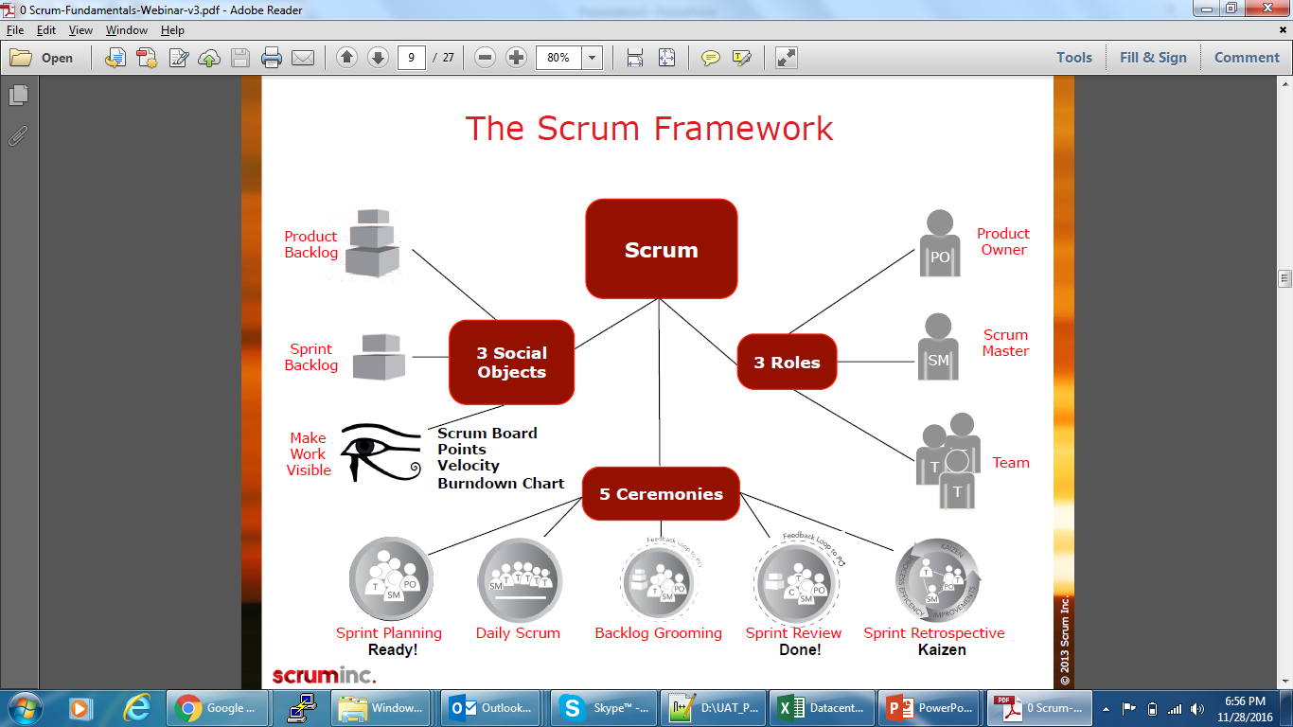

Slide 12
DevOps:
Help in maintaining different versions of software
Help to deploy software in different machines
Helps create efficient ways to install software
Improves collaboration

Slide 13
Happy Trip
Travel and tours website
User can book and cancel packages
User can send queries to the Admin
Admin can view the packages and delete packages

